Slide 1



Eco-Schools Google Drive

Slide 2

Why
Google Drive?

Slide 3
Advantages of
Using Eco-Schools Google Drive
Everyone can access to the information if connect to the internet
All files are editable. You can also make changes to the files
Enable for both laptop and smartphone
WWF can track your Eco-Schools process implementation
Reduce paper usage
Completely free to use

Slide 4
Topics
01
02
03
How to access
Google Drive
How to use
Google Drive
Document Detail
in each folder

Slide 5
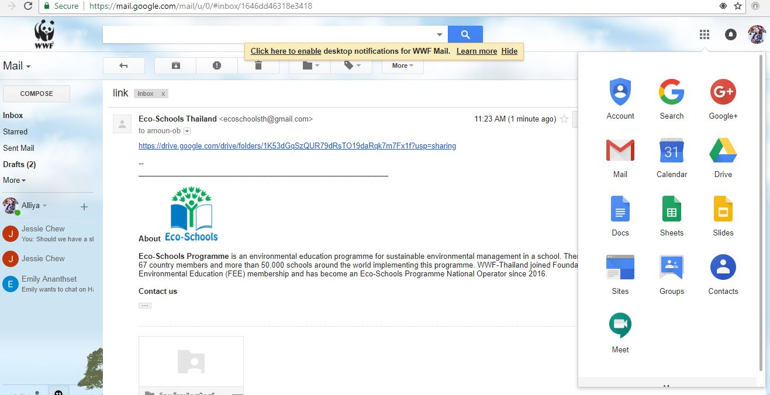
How to access
Via internet browser
Must have a Gmail account
Open an e-mail
from Eco-Schools Thailand
Click on the link
Click on this link

Slide 6
How to access
1
2
OR
Go to your Gmail
Click on menu tap on the upper right
Click on Drive, then go to Google drive
Go to the Google Drive here

Slide 7

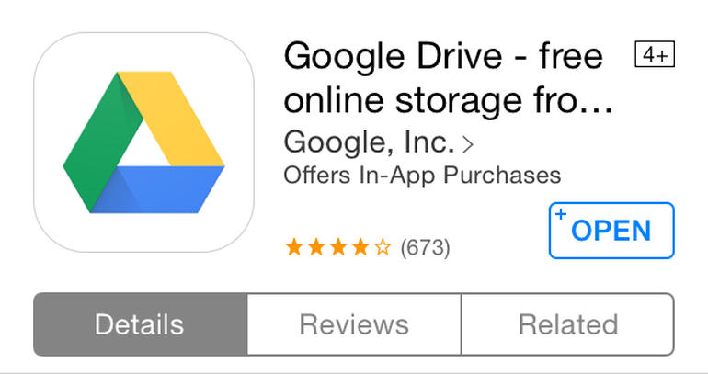
How to access via Smartphone
Google Doc
Google Sheet
These two apps are for
adding the information
A main app to access to google drive
App: Google drive, Google doc, Google sheet
Must have a Gmail account

Slide 8
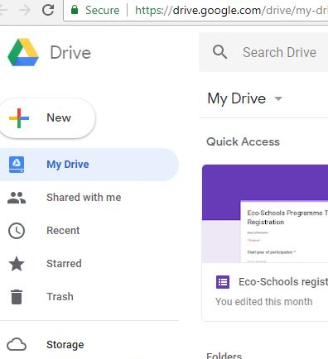
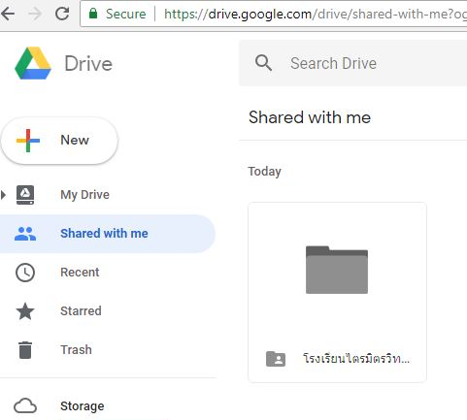
How to use Google Drive
2
1
Google drive: access to the school’s files
> Click on ‘Shared with me’
> Select your school’s folder

Slide 9
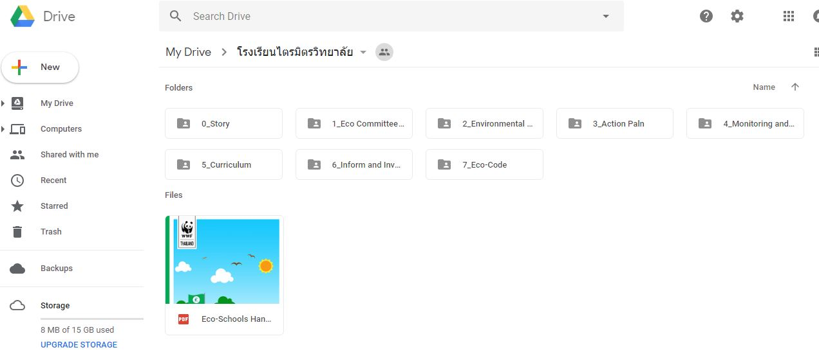
How to use Google Drive
You will see 8 different folders for each Eco-Schools methodology

Slide 10
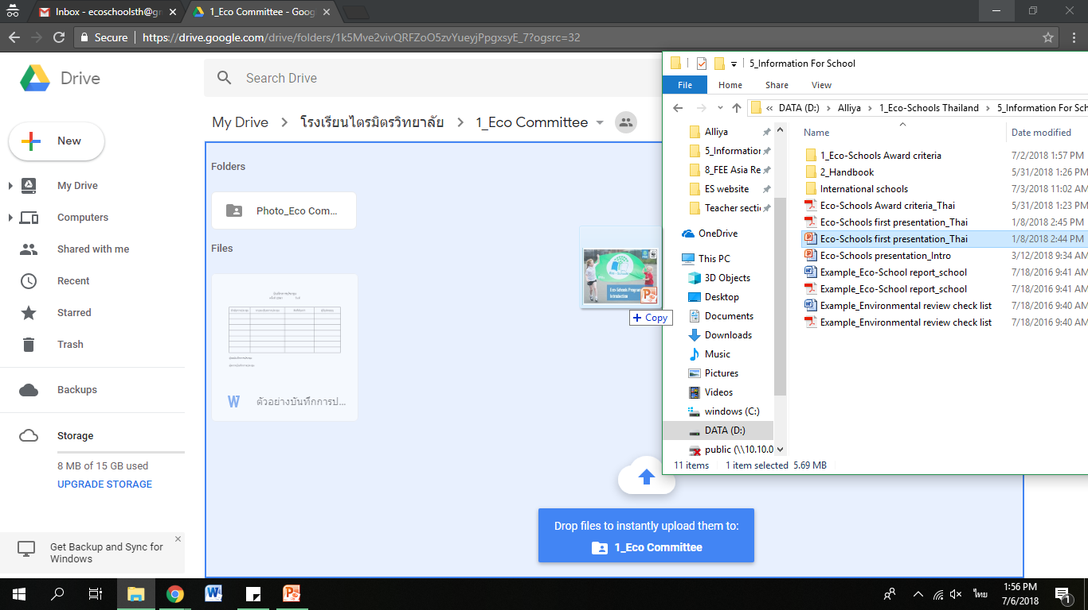
How to use
Google Drive
1
how to add files
1. Click on ‘New’

Slide 11
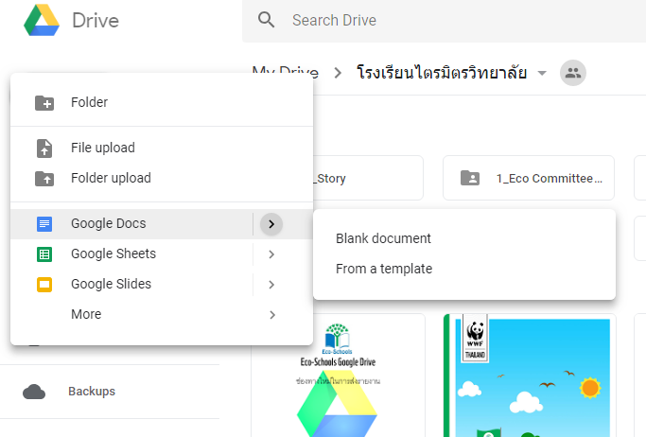
How to use Google Drive
01
02
03
How to add files
Select ‘Folder’ to add more folder
1
2
Select ‘File upload’ to add a file from your device
3
4
Select ‘Google docs’ to add a blank Word for general use
04
Select ‘Google sheets’ to add a blank Excel table

Slide 12
How to use Google Drive
How to add files
Open the folder with
the file
Drag the file to
a space on Google
drive
1
2

Slide 13

Folder 0_Story
An article or story that you want to share which can be something you have learnt, your success or your inspiration
Eco-Schools team will public your story to the Eco-Schools Network
Please add about 2-5 pictures for each story

Slide 14

Folder 1_Eco Committee
The meeting minutes or memo which you can use the example file or your school format
If you have a hard copy of the minutes, please take a photo or scan and upload on this folder
Please upload a formal Eco Committee set up document of your school here
Please add no more than 10 pictures about the meeting

Slide 15

Folder 2_Environmental Review
Please make an environmental review summary in the example file
Please also upload a finish checklist of an environmental review
You can also upload related document such as comments from students, staff and parents
Please add no more than 5 pictures about this topic

Slide 16

Folder 3_Action Plan
A summary of all activities in semester year. If you have a hard copy, please also add it here
Add a document of the activities proposal for the school approval (can be either photo file or PDF)
You can upload all related documents such as how you develop the action plan, participants of an action plan development and etc.
Please add no more than 5 pictures about this topic

Slide 17

Folder 4_Monitoring and Evaluation
Upload all related files on monitoring and comments from others
If you have data in the example file, please fill it in
Please upload no more than 6 pictures for each activity
If you have video, please also upload it

Slide 18

Folder 5_Curriculum
Please fill out in the example file a summary of how you integrate an Eco activities in the curriculum
You should fill out all subjects but you do not have to fill out all level. Please choose some outstanding integrating subjects to fill out.
You can upload related files here
Please upload no more than 10 pictures about the class

Slide 19

Folder 6_Inform and Involve
Fill out how your informing in the example file
You can upload related documents such as a PR script, video and poster
Please upload no more than 15 pictures

Slide 20

Folder 7_Eco-Code
Please fill in a story about the Eco-Code in the example file
If you have any photos or video, please upload it here

Slide 21
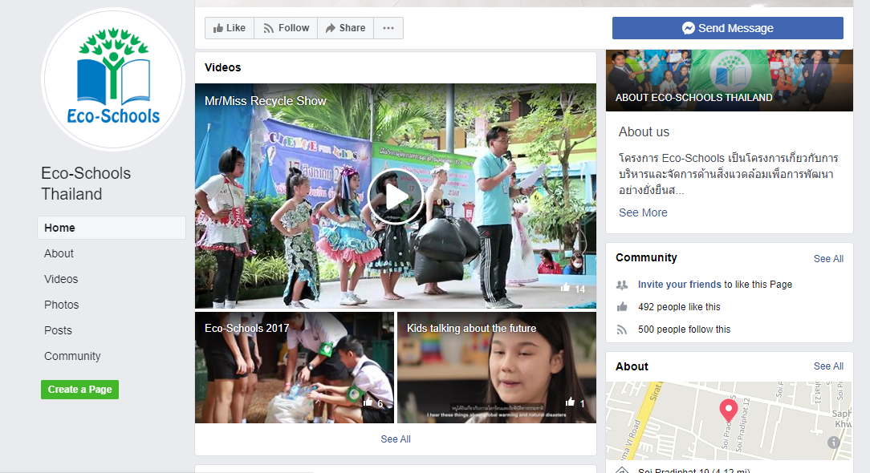
Eco-Schools acebook
Follow the news about
the Eco-Schools Thailand down here
https://www.facebook.com/Eco-Schools-Thailand-1293156000775839/

Slide 22
THANKS
Do you have any questions?
Thitinh@wwf.or.th
ecoschoolsth@gmail.com
094-4843373
Lind ID: pe.ee.em

